Slide 1
Medical Image Analysis
Deep Learning
Nikolaos-Marios Tsarouchas
Marios Vottas

Slide 2
Medical Image Analysis
01 | Motivation
 | Computer vision in Medical field
02 | Experiments
 | Pneumonia Classification & Brain Tumour segmentation
03 | Models
 | CNN, Resnet, Densenet, Unet
04 | Results & Conclusion
 | The results of the models and final conclusion
05 | Future work
 | Work under development for future work

Slide 3
Motivation
Pneumonia
Pneumonia is the single largest infectious cause of death in children worldwide. Pneumonia killed 740.180 children under the age of 5 in 2019.
Brain tumour
There are 120 different types of brain tumor with high fatality rate. Early diagnosis is vital.
Computer Vision
The research of computer vision, imaging processing and pattern recognition has made substantial progress during the past several decades.

Slide 4
Experiments
Pneumonia Classification
Brain Tumour segmentation
Import the Xray Images
Preprocess the images (rescale, normalize, augmentation)
Imbalanced dataset (augment data, adjust weights)
Split the data in test, validation and test
Create model architecture (incl. BatchNormalization & Dropout)
Train several models (CNN, ResNet, DenseNet)
Hyperparameter tuning
Performance of predictions in test set regarding the pneumonia detection
Import MRI images and masks
Preprocess the images and masks (rescale, normalize, augmentation)
Split the data in test, validation and test
Create the architecture of Unet and create a Dice coefficient function
Train the model (we used Early stopping, LR update and model checkpoint)
Performance of predictions in test data
Plot predicted masks for evaluation

Slide 5
Datasets
01
02
X-ray
MRI
5.863 annotated X-Ray images for detecting Pneumonia
110 patients MRI’s comprise of 3929 images and masks for tumour segmentation

Slide 6
Models used
01
03
Custom CNNs
Transfer Learning
3 CNNs with slightly different architecture
ResNet152
DenseNet161
02
04
DenseNet
Unet
DenseNet121 developed with TensorFlow
Developed for Brain MRI segmentation

Slide 7
Pipeline
Import the images
Preprocess the images
Collect the images and import them
Preprocess the images (reshape, normalize, augmentation)
Train the model
Train the Neural Network on training dataset
Tune the Model
Evaluate the model
Evaluate the performance on test set
Hyperparameters tuning to improve performance

Slide 8
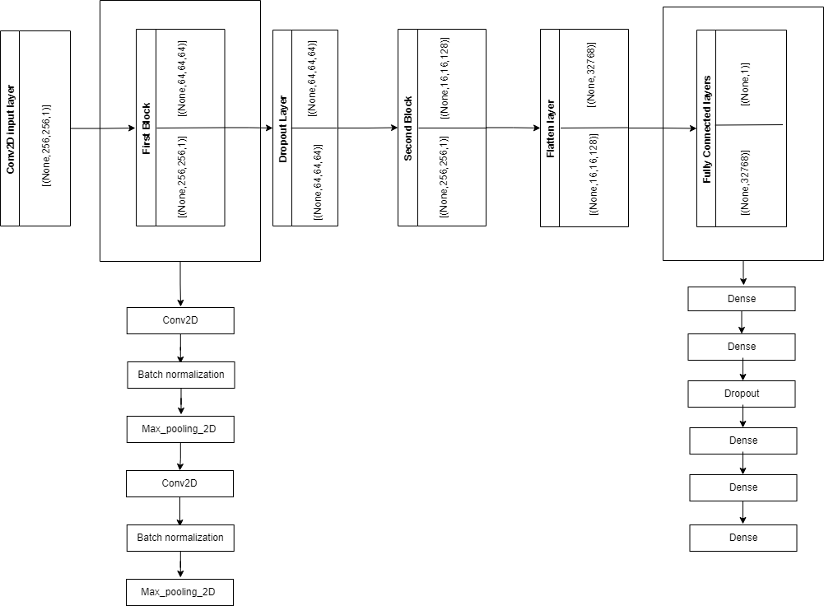
CNN 1 architecture
5 Conv layers
Max pooling
Batch normalization
Drop out
Input (256,256,1)
Model 2 & 3
Similar architecture
Deeper networks (more conv layers, Vanishing Gradients)

Slide 9
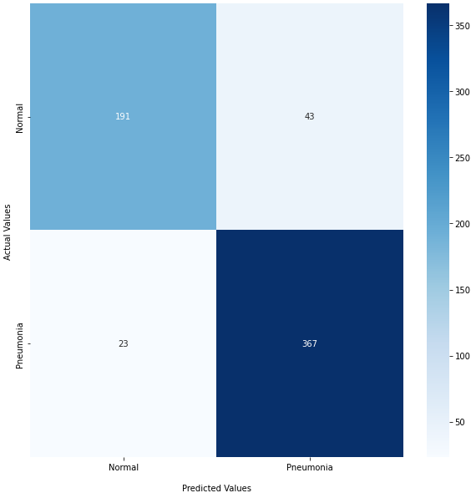
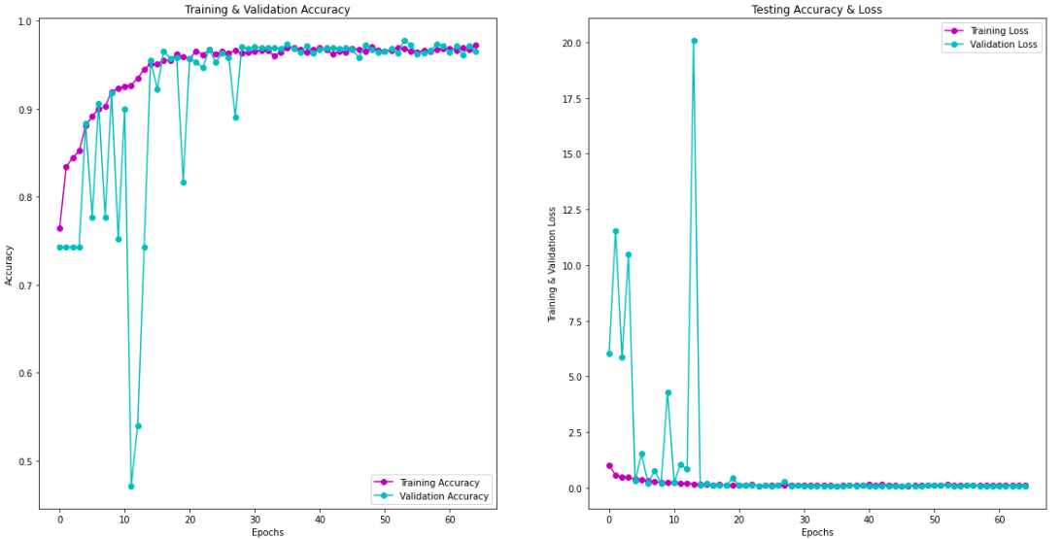
Results CNN model 1
Best out of 3 models
Run for 65 out of 100 epochs
Low tolerance in type 2 errors
Accuracy = 89%
Recall = 94%

Slide 10
DenseNet Comparison
Custom made DenseNet121 vs
Transfer Learning DenseNet161
DenseNet121
DenseNet161 TL
Familiarization with architecture
Custom made changes
95% Recall on the important class
More than any other custom CNN deployed
Familiarization with transfer learning
Pre trained model
Best Recall score in the entire project 98%

Slide 11
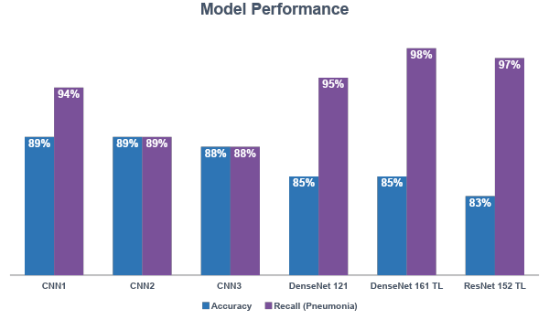
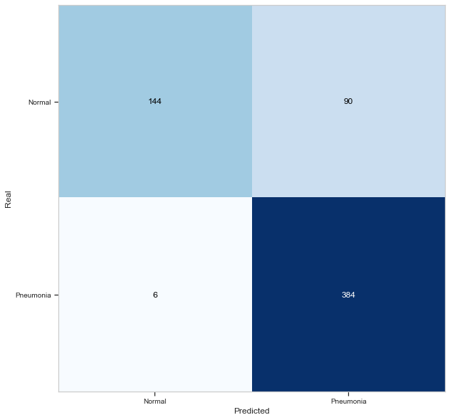
Comparison of Pneumonia Classification results
Type II error is the most important metric and can have a lot of impact in the models real-life usability
DenseNet161 TL has the best results out of all the models with 98% Recall on the Pneumonia class
(only 6 false negatives)

Slide 12
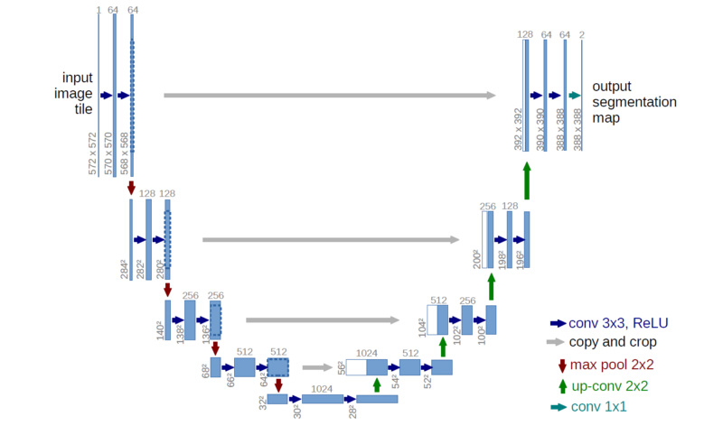

Unet
The left hand side is the contraction path (Encoder) where we apply regular convolutions and max pooling layers.
In the Encoder, the size of the image gradually reduces while the depth gradually increases.
The right hand side is the expansion path (Decoder) where we apply transposed convolutions along with regular convolutions
In the decoder, the size of the image gradually increases and the depth gradually decreases.
Intuitively, the Decoder recovers the information (precise localization) by gradually applying up-sampling
To get better precise locations, at every step of the decoder we use skip connections by concatenating the output of the transposed convolution layers with the feature maps from the Encoder at the same level. After every concatenation we again apply two consecutive regular convolutions so that the model can learn to assemble a more precise output
This is what gives the architecture a symmetric U-shape, hence the name UNET
Concatenations
Dice coefficient: the denominator is the sum of total boundary pixels of both prediction and ground truth, and the numerator is the sum of correctly predicted boundary pixels because the sum increments only when pi and gi match.
Encoder
Decoder

Slide 13
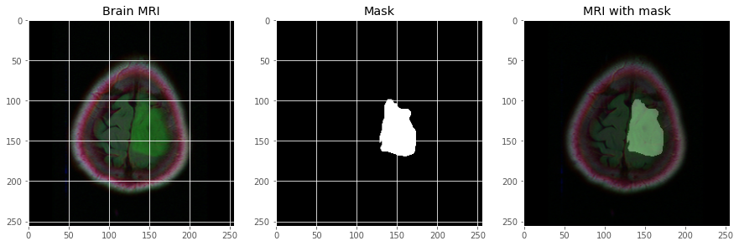
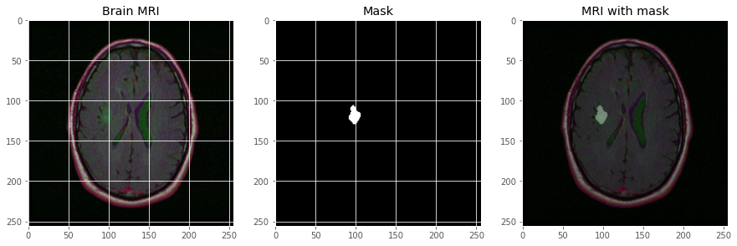
Brain Tumour MRI segmentation with Unet
01
Brain MRI Images with Masks
Image of brain MRI with the mask of abnormality
02
Task
Identify the Abnormality segment
03
Unet
Unet autoencoder will try to solve adequately the task

Slide 14
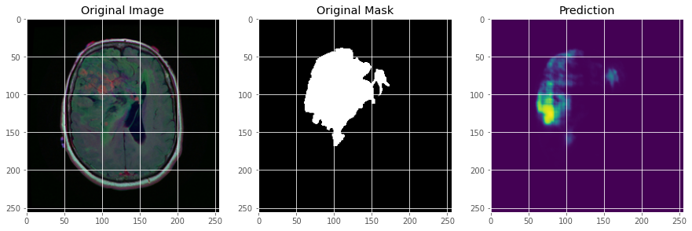
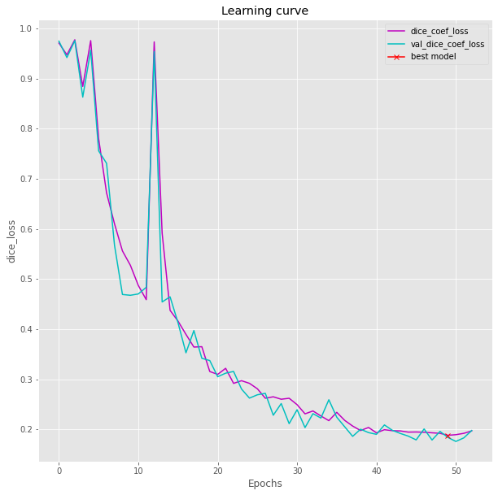
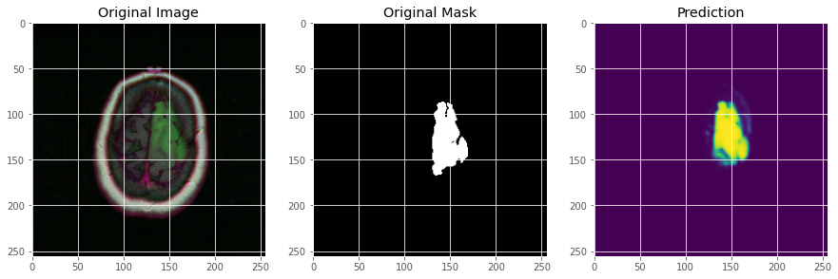
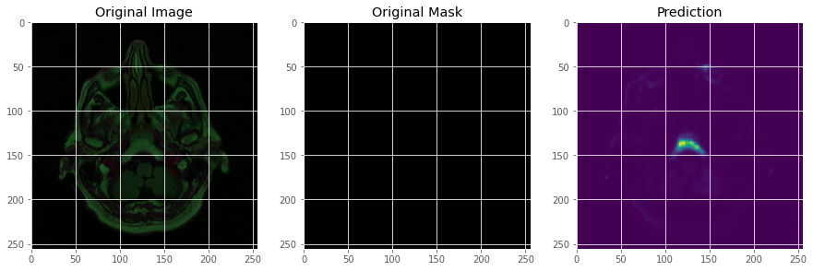
Brain Tumour MRI segmentation with Unet
Best Dice coefficient 0,85

Slide 15
Conclusions
01
02
Transfer Learning
Winner Models
Transfer Learning worked efficiently for Pneumonia Classification
DenseNet and ResNet Gave the best results
Deep learning
DL can be an effective tool in Medicines arsenal
03
04
Segmentation
Capacity
Necessary high CPU & GPU performance. Need for TPU
Finds exact source of the problem (exact size of cancer)

Slide 16
Future Work
Pneumothorax Segmentation
Check Unet in different problem
Depthwise Seperable CNN
Develop a DWCNN for Pneumonia classification
Tune Dice
Tune Dice coefficient and check deeper models & TL
Develop Deeper NN
Develop more models like Resnet, Densenet

Slide 17
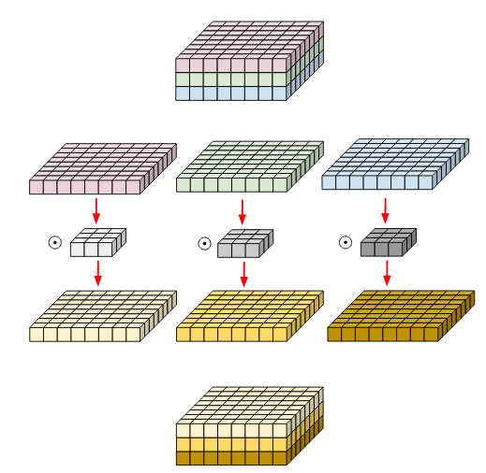
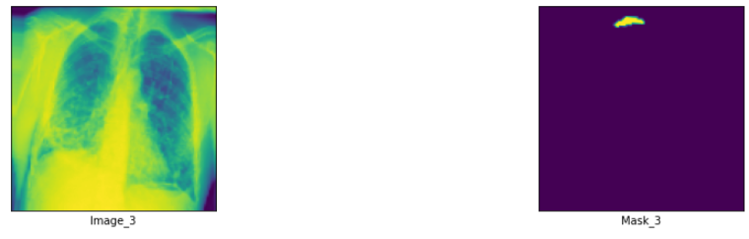
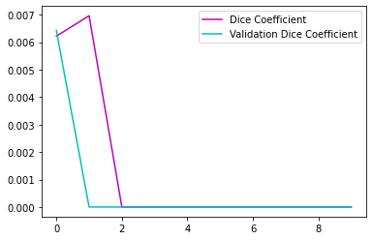
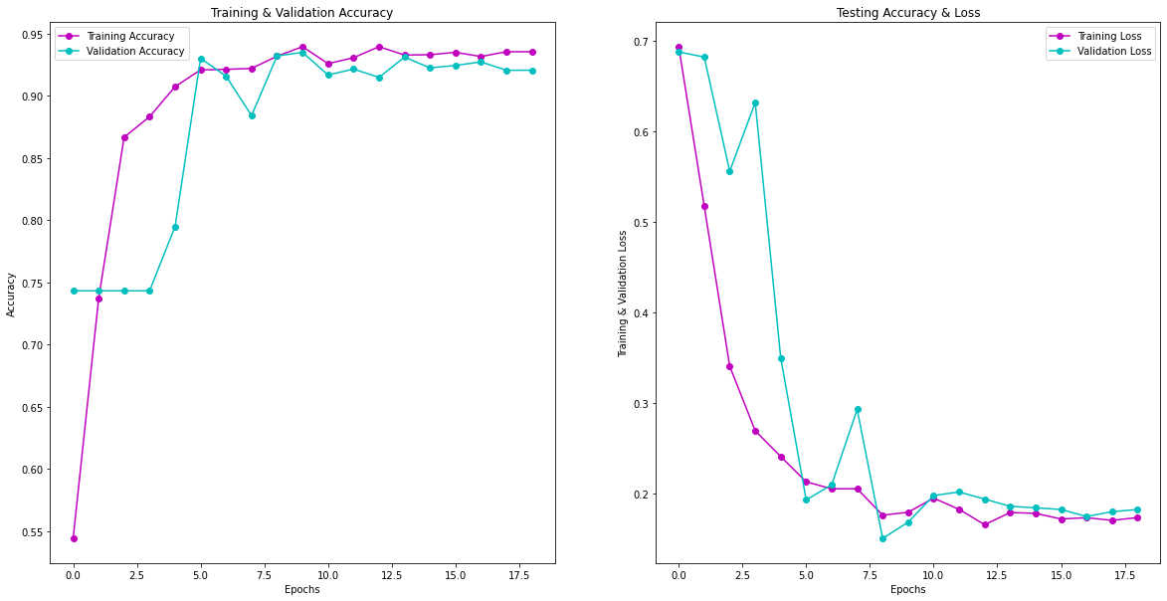
Future Work
Pneumothorax Segmentation
Depthwise Seperable CNN

Slide 18
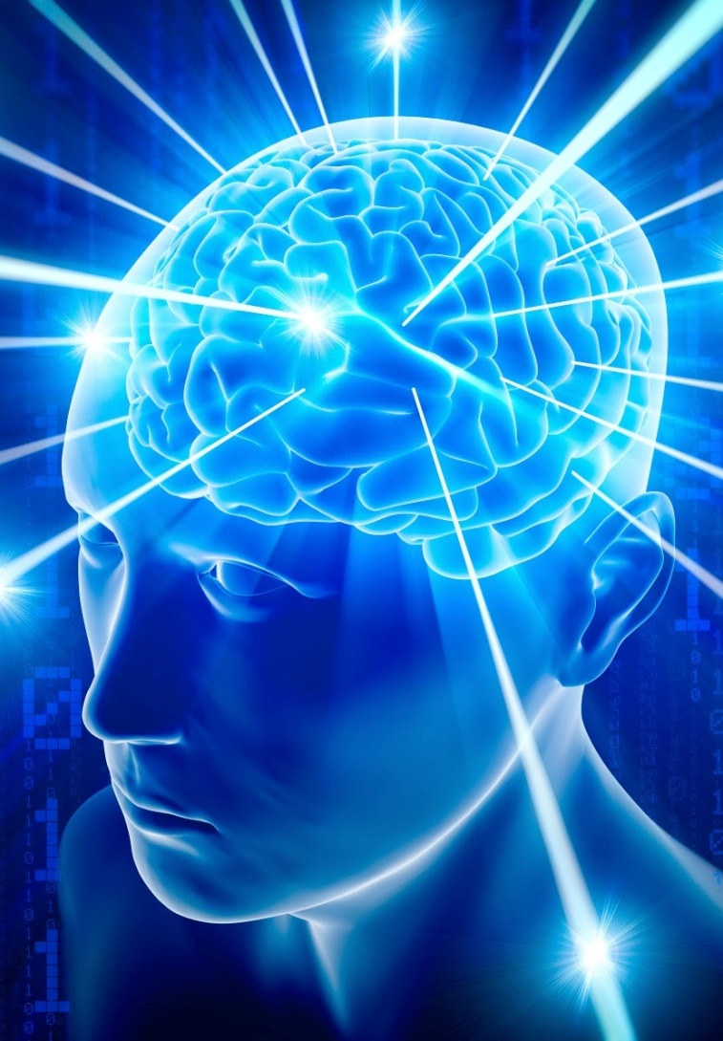
Thank You!!!

